Slide 1
FLIPROBO TECHNOLOGIES HOUSING PRICE PREDICTION
Submitted by:-
TANUJ SWARNKAR

Slide 2
PROBLEM STATEMENT
To build a model to find the independent features which have impact on house price
This model will in turn be used by the builder to understand how exactly the prices vary with the features. They can accordingly manipulate the strategy of the firm and concentrate on areas that will yield high returns.

Slide 3
DATA PREPROCESSING
Handling missing values in
Numerical data
Label Encoding
Feature scaling
Handling missing values in
Categorical column
Dropping inappropriate Columns

Slide 4
HANDLING MISSING VALUES IN NUMERICAL DATA
Handled missing values in numerical data by mean and median. The feature distributed normally is replaced with mean others with median.

Slide 5
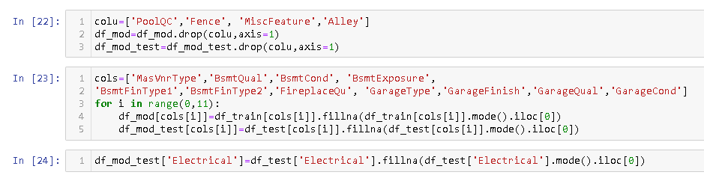
HANDLING MISSING VALUES IN CATEGORICAL COLUMN
Identifying and handling the missing values of categorical column by replacing the null value with mode value

Slide 6
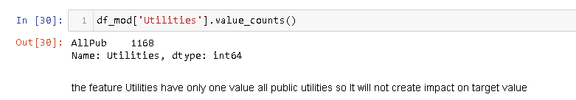
DROPPING INAPPROPRIATE COLUMNS
PoolQc feature have only 0.5% of data, Fence have only 20.2% data and miscFeature have only 3.7% data. We cannot predict using these features so I'm going to drop all three features
The feature Utilities have only one value all public utilities so it will not create impact on target value.

Slide 7
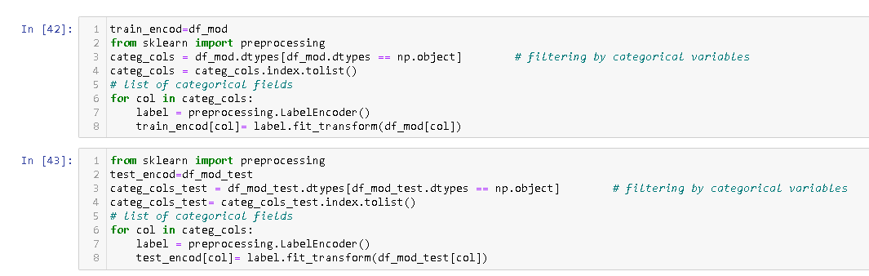
LABEL ENCODING
converting the categorical data into a numeric data using label encoding technique.

Slide 8
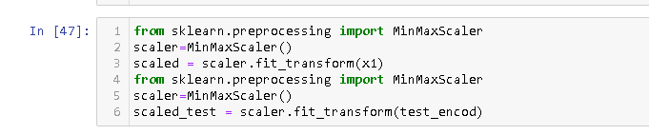
FEATURE SCALING
Transforming un scaled data to scaled data using min max scalar

Slide 9
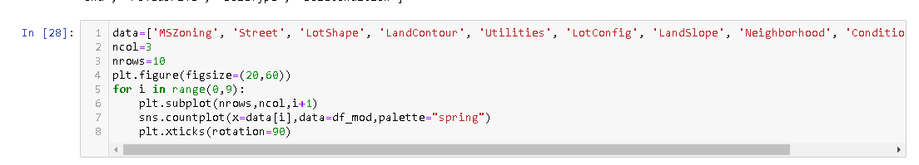
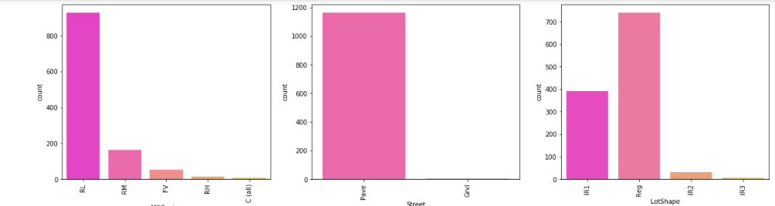
VISUALIZATION
Interpretation of categorical data done by count plot

Slide 10
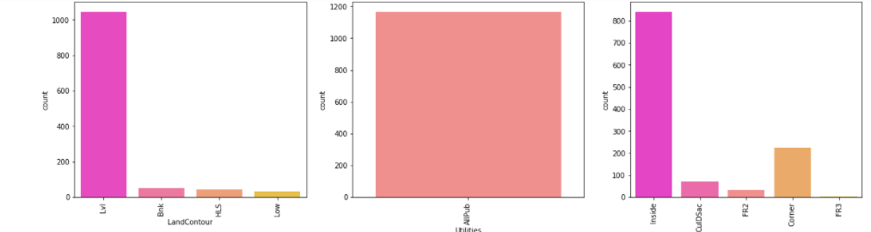
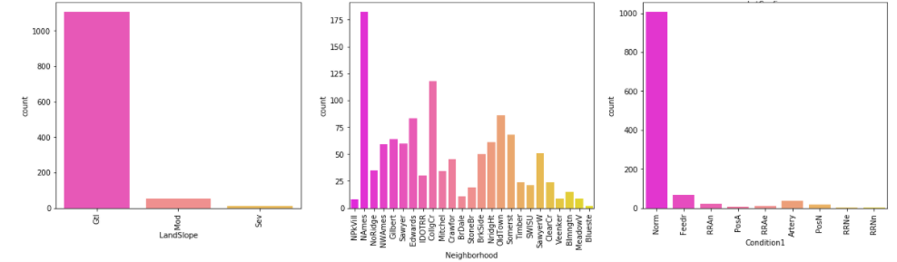
VISUALIZATION

Slide 11
INTERPRETATION OF CATEGORICAL DATA
majority of buyers compromise in basement quality and condition even if it is average they ready to buy.
majority of buyers expecting Gas forced warm air furnace for heating
majority of buyers expecting centralized A/C
majority of buyers expecting Standard Circuit Breakers & Romex for Electricity.
price value is higher for the house having following amenities excellent kitchen quality excellent finished garage excellent fire place garage condition should be typical/Average garage should be attached with house paved drive way functioning-ready to move warranty deed-conventional.

Slide 12
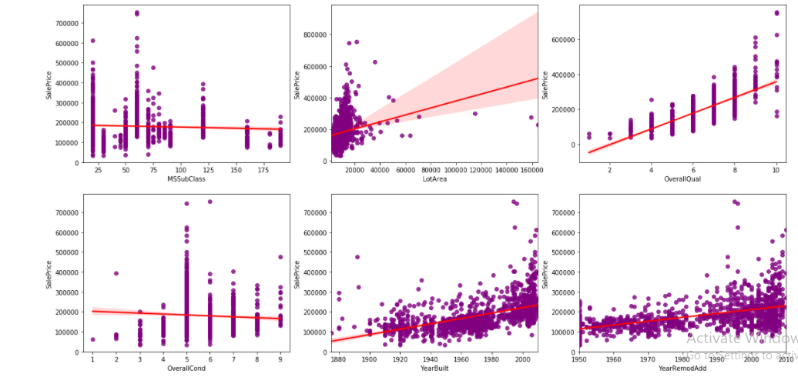
VISUALIZATION
Interpretation of Numerical data done by reg plot

Slide 13
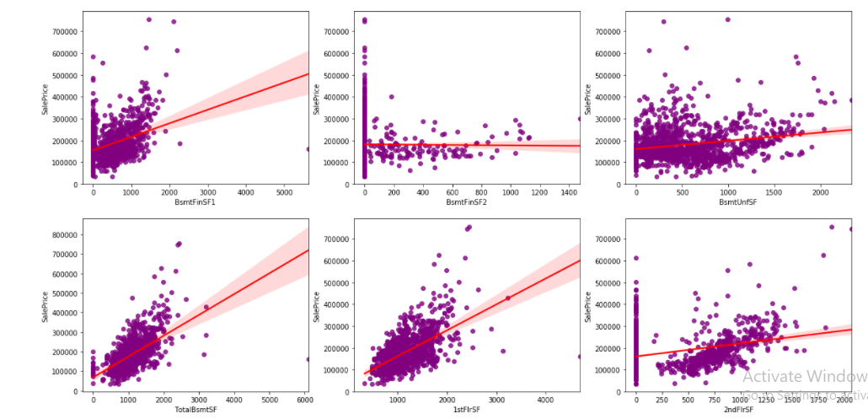
VISUALIZATION

Slide 14
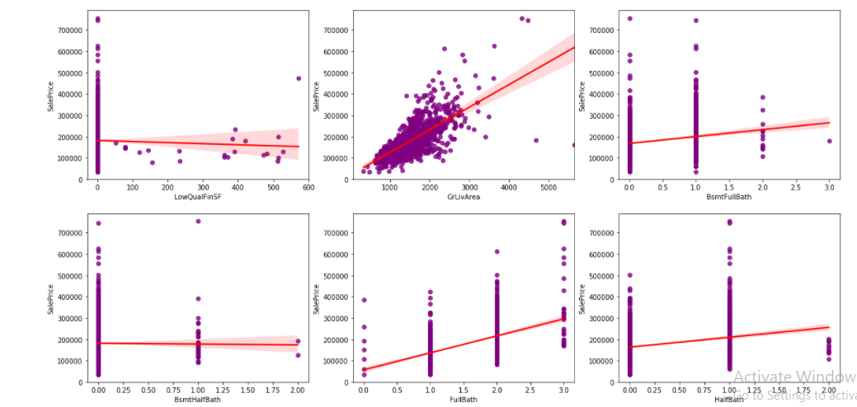
VISUALIZATION

Slide 15
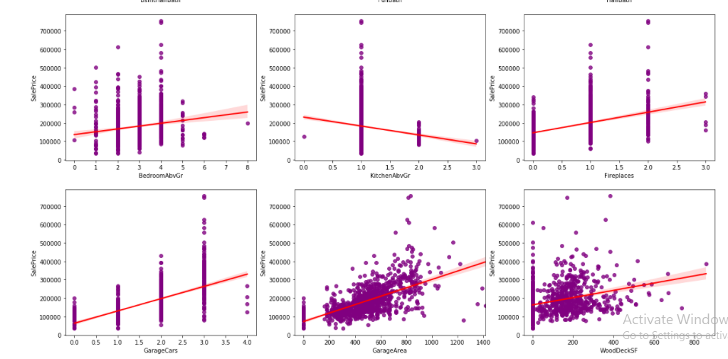
VISUALIZATION

Slide 16
INTERPRETATION OF NUMERICAL DATA
Interpretation of categorical data done by reg plot
All numeric features has linear relationship with sale price
Features MSsubclass,oversllqual,overallcond,Bsmtfullbath,Bsmthalfbath,fullbath,halfbath,bedroomabvgrd,kitchenabgrd,fireplce,garagecars,mosold and yrsold are categorical feature with numerical value
GrLivArea,garagearea,yrbuilt,woodDecksf,totalbsmtsf,1stfloorsf,2ndfloorsf are strongly and positively correlated with sale price

Slide 17
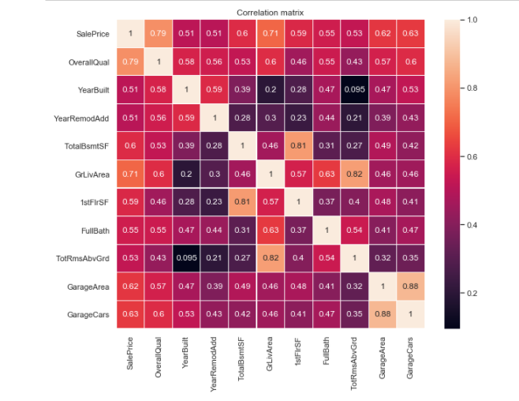
CORRELATION MATRIX

Slide 18
CORRELATION MATRIX
GrLivArea and TotalBsmtSF has a very linearly relation with 'SalePrice'.
All the features are positively related with target, which means that as one variable increases, the other also increases. In the case of 'TotalBsmtSF', we can see that the slope of the linear relationship is particularly high.
OverallQual and 'YearBuilt' and also seem to be related with 'SalePrice'. The relationship seems to be stronger in the case of 'OverallQual', where the scatter plot shows how sales prices increase with the overall quality.
'GarageCars' and 'GarageArea' are also some of the most strongly correlated variables.
'TotalBsmtSF' and '1stFlrSF' are strongly and positively correlated.

Slide 19
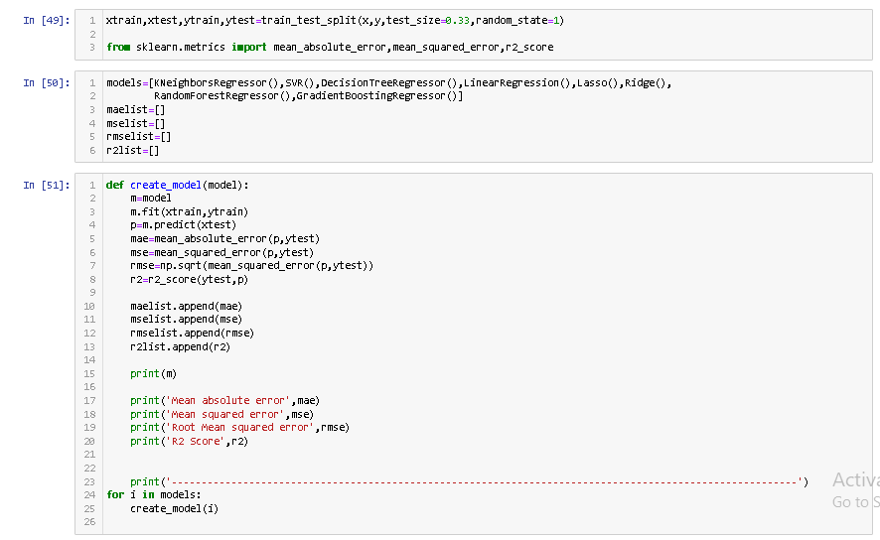
MODEL BUILDING

Slide 20
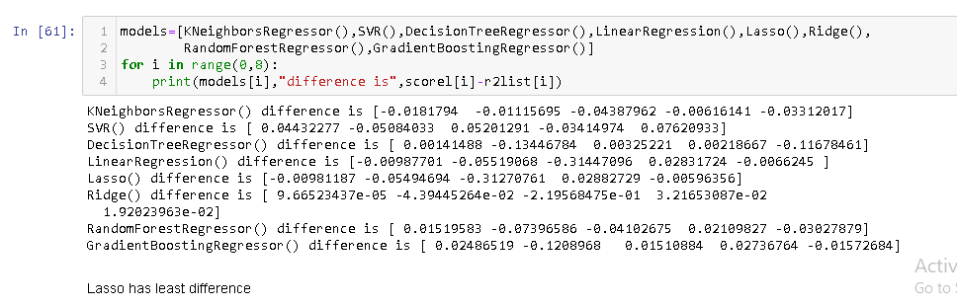
CROSS VALIDATION

Slide 21
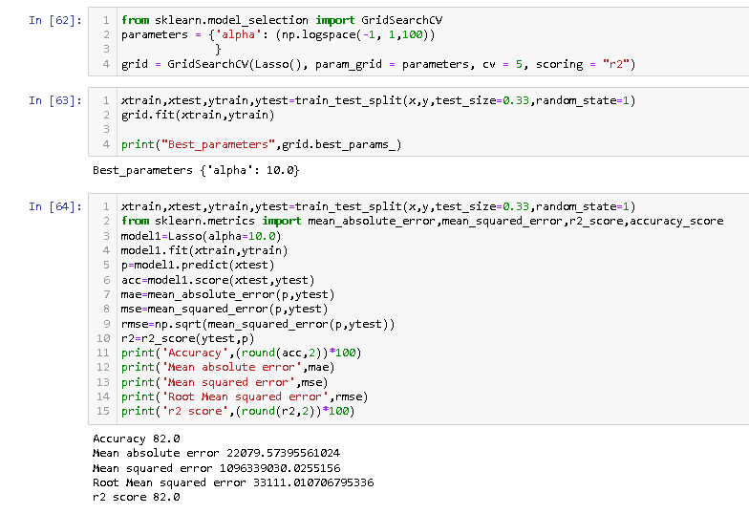
HYPER PARAMETER TUNING
Hyper tuning using grid search cv

Slide 22
CONCLUSION
Best model:Lasso Regression
Best parameter:{'alpha': 10.0} After hyper tuning the accuracy increased to 82%.
The house price prediction model predicts with accuracy of 82%

Slide 23
Thank you

